Slide 1
Chapter 11
Network Security

Slide 2
Objectives
Examine how an attacker gains control of a network
Understand how denial of service attacks are initiated
Examine the security software and hardware used to protect the network
Understand the VPN technologies
Understand wireless security issues

Slide 3
Introduction
An enterprise network is vulnerable to many types of network attacks.
While network attacks can’t be prevented, there are some steps that can be taken to minimize the impact an attack has on the network.

Slide 4
Introduction
The first type of attack examined in this chapter is intrusion, where an attacker gains access to a remote network system.
There are many ways by which an attacker can gain access to the network. These are social engineering, password cracking, packet sniffing, vulnerable software, and viruses.

Slide 5
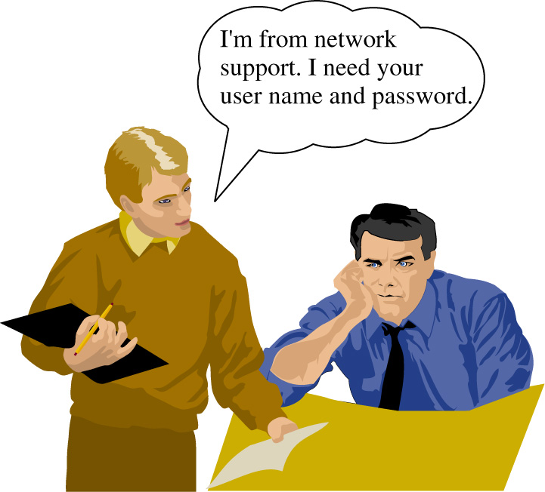
Social Engineering
The first issue of intrusion is social engineering.
This is a way of for an intruder to gain enough information that enables the unauthorized user to gain access to the network.

Slide 6
Social Engineering
An attacker tells a user that they are having trouble with their account and then ask for the user’s name and password.
Often a user will blindly provide the information not realizing that the person calling is not associated with the network and is in fact an attacker

Slide 7
Social Engineering
This gives the attacker an account (username and password) to attack the network. This is just one example of social engineering.
This problem is not completely solvable because as the number of users increases, so does the possible ways to attack the network.

Slide 8
Social Engineering
The solution is educating the user to not share information about they access the network and to always require identification from support staff.

Slide 9
Password Cracking
If the attacker can’t get the password from the user, the attacker can use password cracking. This can be done via brute force or via checking for “weak” passwords. Most networks require the users to use strong passwords
In password cracking, the attacker can try to guess the user’s password. A way is to do this is to use a dictionary attack. The dictionary attack uses known passwords and many variations (upper and lower case and combinations) to try to login to your account.
A brute force attack means the attackers uses every possible combination of characters for the password.

Slide 10
Preventing Password Cracking
Don’t use passwords that are dictionary words
Don’t use your user name
Don’t use your user name backwards
Limit the number of log in attempts
Make you password sufficiently long (6 or more characters) with an alpha numeric combination (e.g. A b 1 & G 2 5 h).
Change passwords often

Slide 11
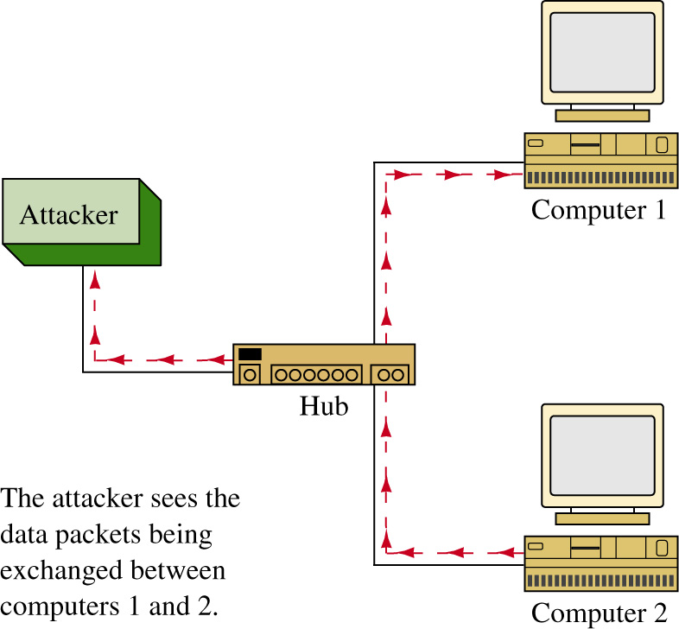
Packet Sniffing
Another way attackers can obtain a password is by sniffing the network’s data packets.
This is easy in a network that uses hubs but not in a network that uses switches to interconnect the computing devices. The attacker will have to insert a device on the network that allows the user to see the data packets.

Slide 12
Packet Sniffing
The attacker will watch the data packets until a telnet or FTP data packet passes or many of the other applications that have unencrypted logins.
Many of these applications pass the user name and password over the network in plain text.

Slide 13
Packet Sniffing
Plain text means that the information is in a human readable form.
If the attacker captures all data packets from a user’s computer then the chances are good that the attacker can obtain the users login name and password on one of the network’s computers.

Slide 14
Packet Sniffing
The way to prevent this is by encrypting the users name and password. An encrypted alternative to telnet is SSH (Secure Shell).
The packets that pass across this SSH connection are encrypted.
SSL (Secure Socket Layer) is an encryption used by web servers. For example, the packet transmission is encrypted when a credit card number is entered.

Slide 15
Packet Sniffing
There is also a secured version of FTP. In these examples, the security is implemented at the application layer. Security can also be implemented at layer three using IPSec (IP Security).
In IPSec each packet is encrypted prior to transmission across the network link. IPSec is also a method used to encrypt VPN tunnels.

Slide 16
Vulnerable Software
In the process of writing large amounts of code, errors happen that can open the access to the code and to a network. The basic attack that capitalizes of these errors is the buffer overflow.
The buffer overflow happens when a program attempts to put more data into a buffer than it was configured to hold. The computer program stack contains data plus instructions that it will run.

Slide 17
Vulnerable Software
For example, a web application could have a vulnerability with long URLs assigned to a variable within the web application.
If the attacker makes the URL long enough then the buffer overflow could allow the attacker’s code to be placed in the stack. When the program counter gets to the inserted code, the inserted code is run and the attacker then has remote access to the machine.

Slide 18
Vulnerable Software
Sometimes buffer overflows don’t allow instructions to be run but rather the application will crash. A common code that gets run in buffer overflow applications is setting up a backdoor to gain entry into the computer.
What the attacker is doing is creating an application on a port and then the attacker can connect to the port. The attacker can also use this to place viruses in the computer.
For example, the attacker finds a vulnerability in the source code for an operating system, e.g. the SSL code on a web server. The attacker downloads malicious code onto the web server and then connects to the machine and instructs the code to begin attacking other machines.

Slide 19
Preventing Vulnerable Software Attacks
Keep the software patches and service packs for the operating system current.
Turn off all services and ports that are not needed on a machine. For example, if your machine does use web service then turn this service off. Leaving these services on is like leaving the windows and doors open to your house. You are just inviting an attacker to come in. If you aren’t using a service, shut the access.
The command netstat –a can be used to display the ports currently open on the windows operating system. This command shows who is connected to your machine and the port number.

Slide 20
netstat -a
c: netstat -a
Active Connections
Proto Local Address Foreign Address State
TCP pc-salsa2:1087 PC-SALSA2:0 LISTENING
TCP pc- salsa2:1088 PC-SALSA2:0 LISTENING
TCP pc- salsa2:135 PC-SALSA2:0 LISTENING
TCP pc- salsa2:137 PC- SALSA2:0 LISTENING
TCP pc- salsa2:138 PC- SALSA2:0 LISTENING
UDP pc- salsa2:nbname *:*
UDP pc- salsa2:nbdatagram *:*
The ports that are listening are just waiting for a connection. For example, ports 135 and 137 are the NETBIOS and file sharing ports for Microsoft. Every port that is established, shows listening and that port can accept a connection. For example if your application is vulnerable and it is listening then the machine is vulnerable to an attack. It is good idea to check to see what applications are running on your machine. It is also a good idea to turn off ports that are not needed. The steps for turning off ports depends on the application. For example, if port 80 is running (WEB – IIS) then go to the Windows services and turn off web the web applications.

Slide 21
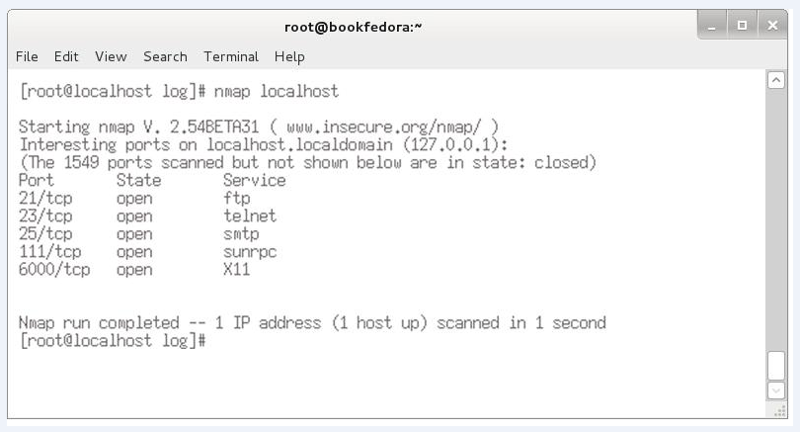
nmap port scanner
This is a port scanner that is used by the network administrator to scan a local computer or other computers internal to the network to determine what network ports and services are being made available to users. An example is provided below.

Slide 22
nmap port scanner
The scan shows that the ftp, telnet, smtp (email server), sunrpc (network file server), and X11 (the GUI for Linux) are all available. Notice that each service has a port number assigned to it.

Slide 23
nmap port scanner
There are many important issues that the network/system administrator faces, but security should be the top concern. When you first go out to install a new service or are maintaining existing systems, the most important issue is the system security and preventing outside threats.
The following is a list of some of the questions that should be asked:
Who will be the users of the software, and what applications are they going to be running?

Slide 24
nmap port scanner
There are many important issues that the network/system administrator faces, but security should be the top concern. When you first go out to install a new service or are maintaining existing systems, the most important issue is the system security and preventing outside threats.
The following is a list of some of the questions that should be asked:
Will they need special permissions?

Slide 25
nmap port scanner
There are many important issues that the network/system administrator faces, but security should be the top concern. When you first go out to install a new service or are maintaining existing systems, the most important issue is the system security and preventing outside threats.
The following is a list of some of the questions that should be asked:
Will the software being installed require a firewall?

Slide 26
nmap port scanner
There are many important issues that the network/system administrator faces, but security should be the top concern. When you first go out to install a new service or are maintaining existing systems, the most important issue is the system security and preventing outside threats.
The following is a list of some of the questions that should be asked:
Does the software introduce any security threats?

Slide 27
penetration testing
A penetration test is a way to evaluate the security of the user’s network.
This is accomplished by trying to exploit vulnerabilities in the network. This includes identifying any potential problems with the operating systems, service and applications as well as verifying user adherence to policies.
The penetration test will also validate any protection mechanisms currently in place.

Slide 28
Viruses
A virus is a piece of malicious piece of code that when run on your machine will open a backdoor to the machine, might start a program that attacks other applications. Problems caused by viruses include:
annoyance
clogging up the mail server
denial of service
data loss
open holes for others to access your machine
attack other machines or networks on demand
Worms are a type of computer virus that typical proliferate by themselves.

Slide 29
Viruses
Today, most viruses are exchanged via attachments via email.
For example, a user receives an email that says “Look at this!” trying to coax the user into opening the attachment. If the attachment is opened the user’s computer could possible become infected.

Slide 30
Steps for Preventing Viruses
Only open attachments that come from known sources. Even this can be a problem because email addresses can be spoofed or the message can come from a known person whose computer has been infected.
Always run a virus check software on the client machines. The virus checker will catch most viruses.
Include e-mail server filters
Keep the virus software up to date

Slide 31
Malware
Nowadays, malware is the term that is being used to encompass all malicious programs intended to harm, disrupt, deny, or gain unauthorized access to a computing system.
Malware is short for malicious software. Viruses are worms are considered a type infectious malware.

Slide 32
Malware
It is important to understand that an intruder can gain network access or even control of your network.
Remember, the information presented in this chapter is an example of what the hacker already knows and what the network administrator needs to know to protect the network.

Slide 33
Denial of Service
Denial of Service (DoS) means that a service is being denied to a computer, network, or network server.
Denial of Service attacks can be on individual machines or the attack can be on the network that connects the machines, or the attack can be on both machines.
You can have denial of service attacks by exploiting software vulnerabilities. For example, a vulnerability in the software can permit a buffer overflow causing the machine to crash. This effects all applications even secure applications.

Slide 34
Denial of Service
The vulnerable software denial of service attack attacks the system by making the system reboot repeatedly.
The denial of service attacks can also be on routers via the software options that are available for connecting to a router.
For example, SNMP management software is marketed by many companies and is supported by many computer platforms. Many of the SNMP packages use a similar core code that could contain the same vulnerability.

Slide 35
SYN Attack
Another denial of service attack is a SYN attack. This refers to the TCP SYN (synchronizing) packet (introduced in Chapter 6).
An attacker sends many TCP SYN packets to a host opening up many TCP sessions.
The host machine has limited amount of memory set aside for open connections.

Slide 36
SYN Attack
If all the TCP connections are opened by the SYN attack, other users are kept from accessing services from the computer because the connection buffer is full. Most current operating systems and take counter-measures against the SYN attack.
Denial of Service attacks can affect the network bandwidth and the end points on the network.

Slide 37
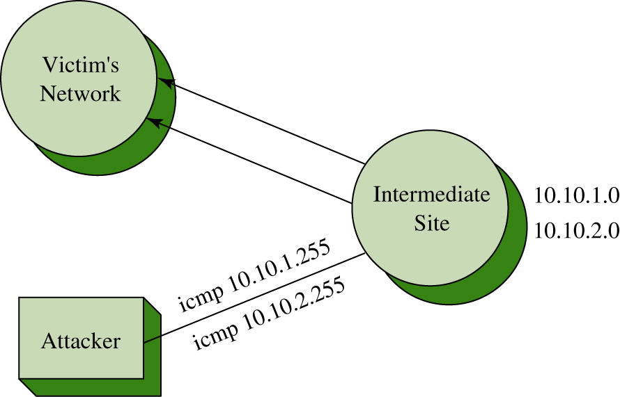
Smurf Attack
Attackers hacks into an intermediate site.
The attacker sends a packet to 10.10.1.255 which is a broadcast address for the 10.10.1.0 subnet.
All of the machines on the 10.10.1.0 subnet will send a reply back to the source address.

Slide 38
Smurf Attack
If this attack was increased to all of the subnet’s in the 10.0.0.0 network then an enormous amount of data packets will be sent to the victim’s network.
This enables the attacker to generate a lot of data traffic on the victim’s network without requiring the attacker to have many resources.

Slide 39
Stopping Layer 3 Broadcasts
But aren’t layer-3 devices supposed to stop broadcasts?
This is true for general broadcasts (all 32 bits set to 1’s or “F F F F F F F F” or 255.255.255.255). Routers will always stop these broadcasts. The type of broadcast used in this attack is a “directed broadcast” and these broadcasts are passed through the router.

Slide 40
Preventing Surf type attacks
Cisco routers have an interface command
no ip directed broadcast
This blocks broadcast packets to that subnet. This prevents a network from becoming an intermediate site for a network attack such as this. Make sure this command or a similar command is a default or has been enabled on the router’s interface
The no ip directed broadcast command enables only the router to reply.

Slide 41
Prevention
To prevent your network from becoming a host for an attacker, use access lists to only allow specific sources for the network on each of the router’s interfaces.
For example, network B connects to a router. Only packets from Network B are allowed to pass through the router.
The downside of this is it does become a maintenance problem, keeping track of the access lists, and processing access lists in processor intensive and can slow down the throughput of the packets.

Slide 42
Prevention
This does help eliminate spoofed packets. Spoof means the attacker doesn’t use his IP address but will insert an IP address from the victim’s network as the source IP. There is a lot of software on the Internet that enables someone to spoof an IP address.
To prevent yourself from becoming a victim, well … there isn’t a way unless you aren’t connected to any network or any other users.

Slide 43
Distributed Denial of Service
Attackers now use worms to distribute an attack. The attacker will do a port scan and look for an open port that is vulnerable to an attack.
The machine is attacked and distribute their malicious software from the hacked machine. The attacker will repeat this for many victim machines.
Once the software is on the victim machines, the attacker can issue a command or instruction that starts the attack on a specific site.

Slide 44
Distributed Denial of Service
The attack will come from potentially a massive amount of machines that the work has infected.
To stop DDoS attacks, stop intrusions to the network. The bottom line is PREVENT INTRUSIONS.

Slide 45
Introduction
A healthy network starts from within and the most basic component in the network is an individual computer.
An individual computer should have similar protection as its big network. Remember, the fundamental of DDoS is to take control of vulnerable machines and launch the attack.

Slide 46
Introduction
It is not cost effective to guard each computer with dedicated hardware, but there are many security software packages that can help.

Slide 47
Antivirus Software
The first line of defense against the viruses and worms is antivirus software.
It is always recommended that every computer have an antivirus installed. Even though antivirus software cannot give 100% protection, it will protect against most of the viruses out there.

Slide 48
Antivirus Software
Antivirus software uses so-called signatures or definitions to match against the viruses and worms.
Each virus or worm has its own trait and this trait is defined in a signature or a definition.

Slide 49
Antivirus Software
This is why it is important to keep the antivirus software up-to-date.
Most of the antivirus software is launched at the start up of the operating system, and it will try to update its signatures or its definitions at that time.
When a virus is found on the computer, the virus program is usually quarantined or removed.

Slide 50
Network Access Quarantine Control (NAQC)
When a virus is found on the computer, the virus program is usually quarantined or removed.
Network Access Quarantine Control (NAQC) is a Resource Kit tool in Windows Server that allows administrators to prevent remote client computers from connecting to their network with machines that aren't secure.

Slide 51
Personal Firewall
Another software protection that is readily available for a computer is a personal firewall.
Most of the operating systems (Windows, Mac OS, Linux) today are equipped with a personal firewall.
Some of them might not be enabled by default. The personal firewall software is typically based on basic packet filtering inspections where the firewall accepts or denies incoming network traffic based on information contained in the packets’ TCP or IP headers.

Slide 52
Personal Firewall
The Windows 10 firewall allows for both packet filtering and application based firewall. It also gives the firewall software both inbound and outbound control.
In the Linux world, iptables has been a de facto firewall program for a long time. Iptables is a network packet filtering firewall program.
Mac OS X uses ipfw, a BSD Linux based firewall. Starting in version 10.5, Mac OS X turned to an application based firewall instead.

Slide 53
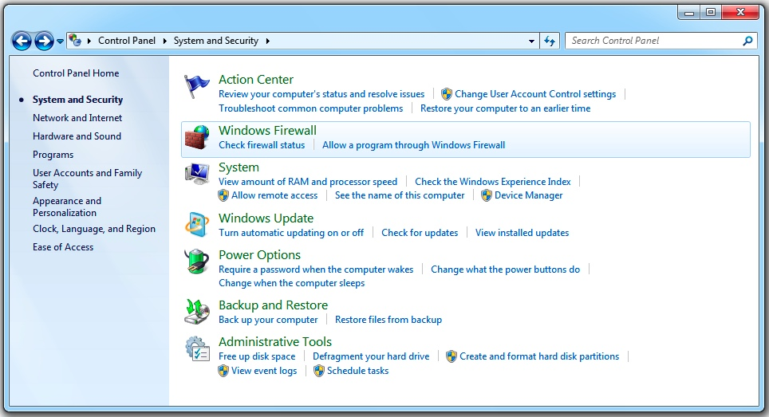
Windows 10 Firewall
To start the Windows 10 firewall configuration use the following steps:
1. Click Start and select Connect To, then select System and Security.
2. The Windows Firewall is shown above and it presents 2 options: Check firewall status and Allow a program through Windows Firewall.

Slide 54
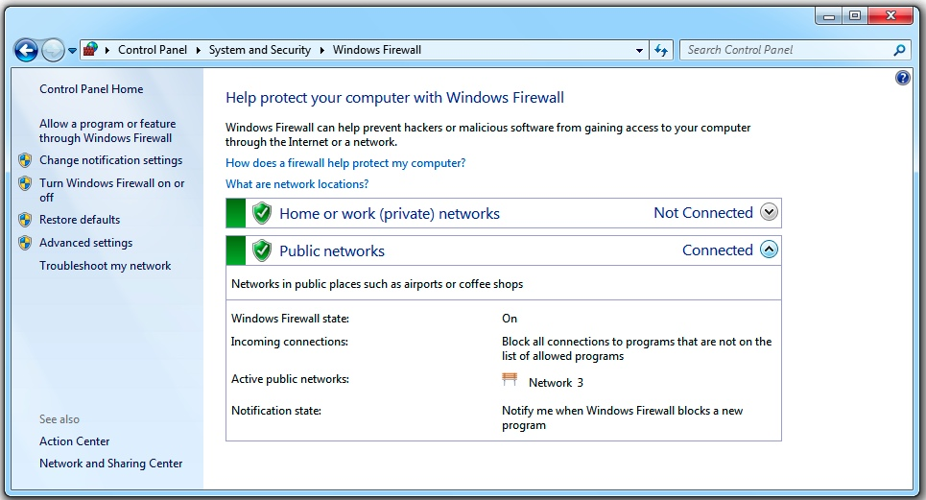
Firewall Status
When selecting Check firewall status, the status window will show up.
It indicates that the firewall is on for the public network connection named “Network 3” and the firewall is blocking all connections to the programs that are not on the allowed program list.

Slide 55
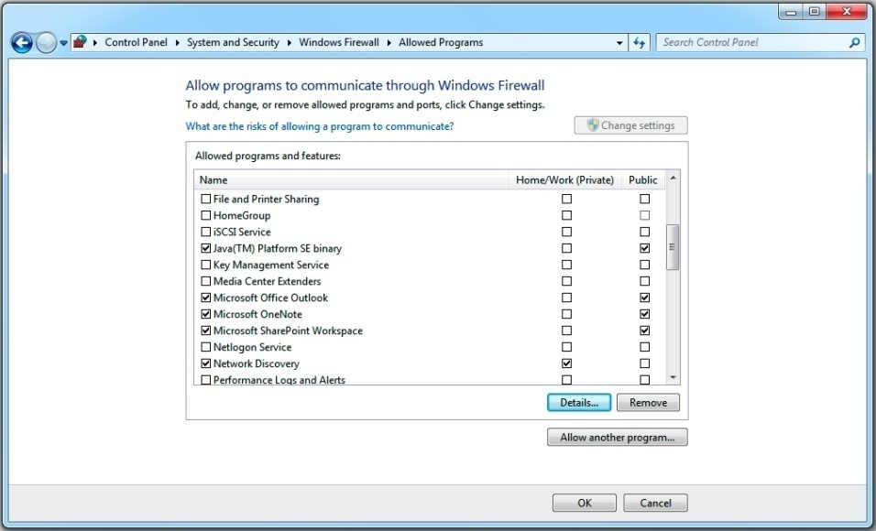
Allowed Programs
When selecting Allow a program through Windows Firewall, the Allowed Programs window will be displayed as shown.
This shows that programs that are allowed through the firewall depending on what network location profile the computer is using.

Slide 56
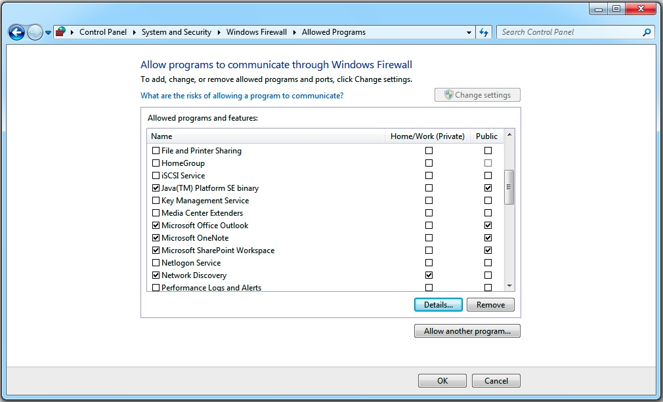
Allowed Programs
Every time, a Windows 10 computer is making a brand new network connection, Windows 10 prompts the user to identify whether this network connection is for home, work, or public location.
It then adjusts the firewall and security settings accordingly.

Slide 57
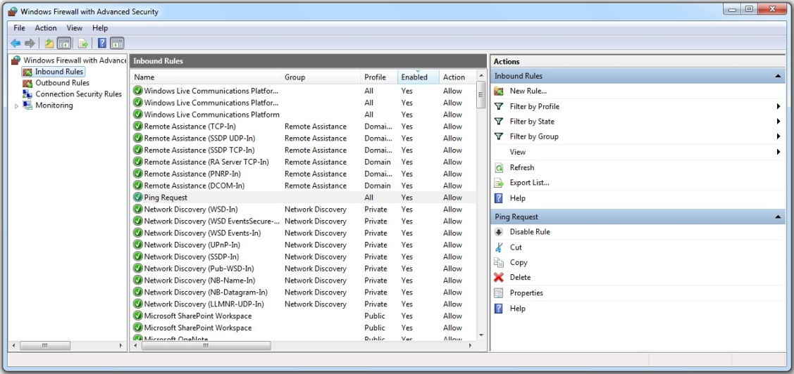
Advanced Settings
Windows 10 also offers advanced firewall settings. Through the advanced option, a user can control both the inbound and outbound traffic to the computer.
The advanced firewall settings can be found on the left column of the firewall status window as shown.

Slide 58
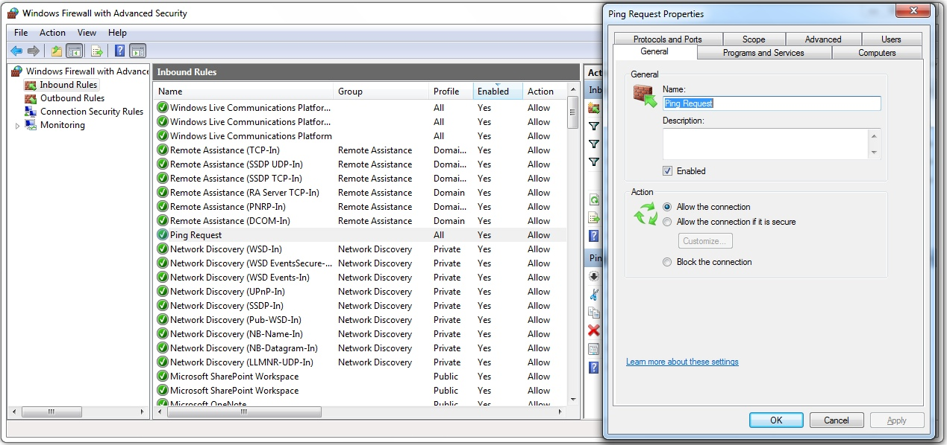
Ping Request Properties
The following example examines an inbound “Ping Request” rule by Windows 10.
On the advanced security windows, and Inbound Rules is selected, the middle pane shows all the firewall inbound rules.

Slide 59
Ping Request Properties
The enabled rules are indicated by the value “Yes” in the column “enabled”. Right next to the “enabled” column is the “Action” column.
This column displays the action of “allow” as to allow the connection or “block” as to deny the connection

Slide 60
Ping Request Properties
When double-clicking on the rule “Ping Request” in the middle pane, the Ping Request properties window is displayed as shown.
On the general tab of this window, the rule is set to enabled and the action is set to allow the connection.

Slide 61
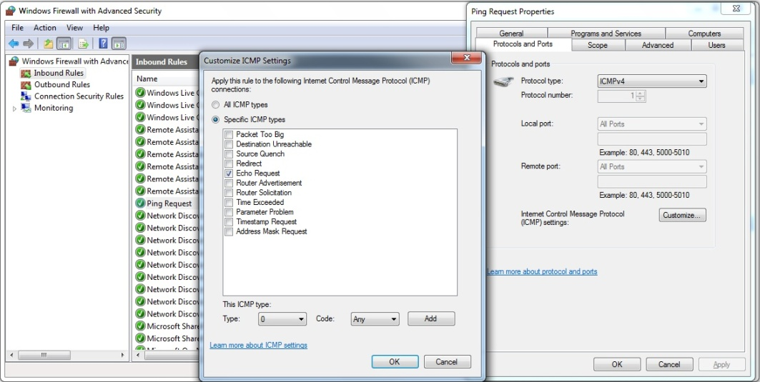
Ping Request Protocol
This figure is displayed when selecting the Protocols and Ports tab.
This illustrates how the firewall program matches the Ping Request by defining its protocol as an ICMPv4 protocol. The “Customize” button will bring up the Customize ICMP Settings, which shows the “Echo Request” ICMP type is selected.

Slide 62
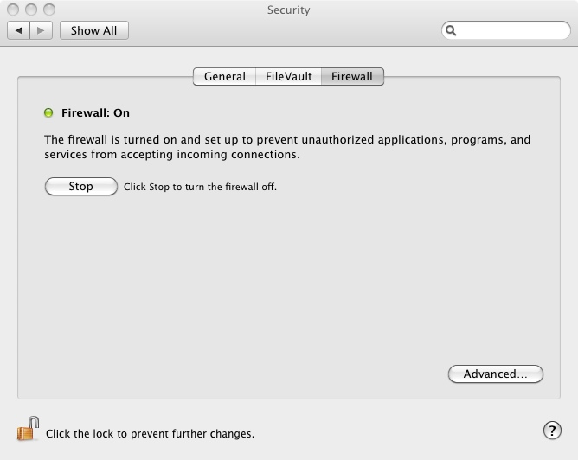
Mac OS X Firewall
To start the Mac OS X firewall configuration use the following steps:
1. Go to System Preferences and select Security.
2. On the Security window, select “Firewall”. The firewall window displays the status of the firewall and gives a user to turn the firewall off.

Slide 63
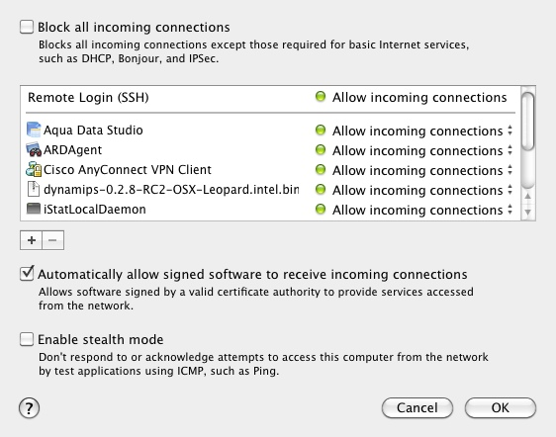
Advanced Settings Mac OS X
The “Advanced” button opens another window for more advanced settings as shown. The advanced options are
Block all incoming connections
Automatically allow signed software to receive incoming connections

Slide 64
Advanced Settings Mac OS X
Enable stealth mode – This option basically stops the computer from responding to an ICMP Ping request packet. Hence, this makes it difficult for attackers to identify the computer..

Slide 65
Linux Firewall
To start the Linux firewall, iptables, configuration use the following steps:
1. The command to view/add/modify/delete the Linux firewall configuration is “iptables”. For example to view the firewall configuration, simply issue the command “iptables --list” as root or “sudo iptables --list”. the user must be connected as root or Go to System Preferences and select Security.

Slide 66
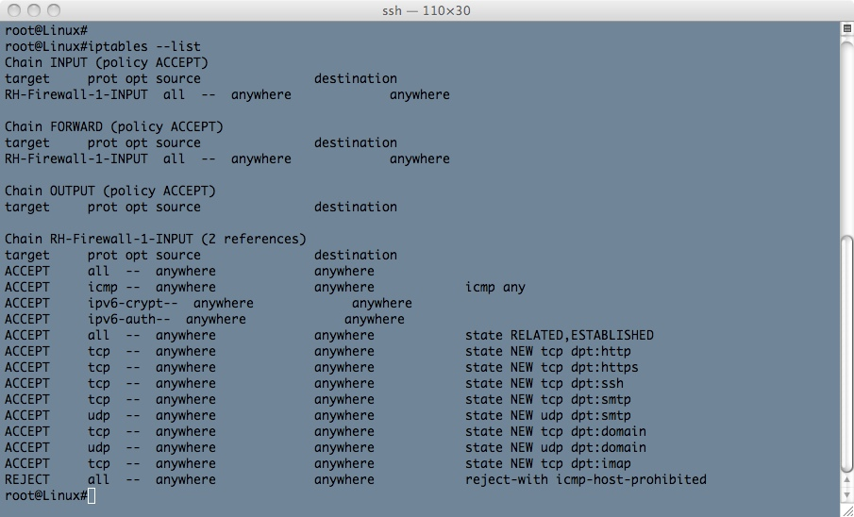
Linux Firewall
2. The output of the command iptables --list is shown. It shows a list of chains, INPUT, FORWARD, OUTPUT, and RH-Firewall-1-INPUT.
The only chain in this example that contains firewall rules is the RH-Firewall-1-INPUT. This chain allows incoming http, https, ssh, smtp, domain (DNS), and imap traffic, it will reject any incoming traffic that does not match the allowed list.

Slide 67
Firewalls
Firewalls are used in computer networks for protection against the “network elements” (for example, intrusions, denial of service attacks, etc.).
Access lists (ACLs) are the basic form of firewall protection, although an access list is not stateful and is not by itself a firewall.
Access lists can be configured on a router, on a true dedicated firewall, or on the host computer.

Slide 68
Firewalls
Firewalls allow traffic from inside the network to exit but don’t allow general traffic from the outside to enter the network.
The firewall monitors the data traffic and recognizes where packets are coming from. The firewall will allow packets from the outside to enter the network if they match a request from within the network.
Firewalls are based on three technologies:
• Packet filtering
• Proxy server
`• Stateful packet filtering

Slide 69
Packet Filtering
In packet filtering, a limit is placed on the packets that can enter the network.
Packet filtering can also limit information moving from one segment to another. ACLs are used to enable the firewall to accept or deny data packets.
The disadvantages of packet filtering are
• Packets can still enter the network by fragmenting the data packets.
• It is difficult to implement complex ACLs.
• Not all network services can be filtered.

Slide 70
Firewalls
A general rule of thumb is to place the firewall close to the machines you want to protect (for example, the network servers).
Do not assume that the clients on the network will never attack your system. Clients can and will get viruses on their machines.
Create demilitarized zones (DMZ)for the outside servers, which mean that they are moved to a place on the network so that they are isolated. If the machines are compromised, the intruder will have limited access to the inside of the network.

Slide 71
Proxy Server
A proxy server is used by clients to communicate with secure systems using a proxy. The client gets access to the network via the proxy server.
This step is used to authenticate the user, establish the session, and set policies. The client must connect to the proxy server to connect to resources outside the network.
The disadvantages of the proxy server are
• The proxy server can run very slow.
• Adding services can be difficult.
• There can be a potential problem with network failure if the proxy server fails or is corrupted.

Slide 72
Stateful Firewall
In a stateful firewall the inbound and outbound data packets are compared to determine if a connection should be allowed.
This technique is used to protect the inside of the network from the outside world but still allow traffic to go from the inside to the outside and back.
The firewall needs to be stateful to accomplish this.

Slide 73
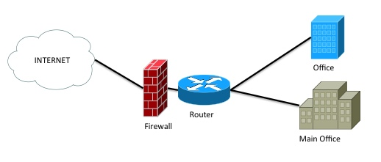
Perimeter Firewall Deployment
A firewall is usually placed in-line between a trusted (internal) network and an untrusted (external) network.
Its primary function is to protect its trusted network.
An example of how a perimeter firewall is often deployed is provided

Slide 74
Firewalls
A big problem with firewalls is that users assume a firewall catches all possible problems.
This is a wrong assumption. The user may be slow to update the patches and fixes to the software.
A firewall is not the end-to-end solution.

Slide 75
Other Security Appliances
There are more security appliances in the market today that help protect the network.
IPS (Intrustion Prevention System) monitors and analyzes the network traffic. In real time, it identifies misuse and anomaly on the network.
The IPS detects a misuse intrusion by matching the network packets with its IPS signatures for known attacks or activities that are classified as bad.
The IPS has an ability to stop or prevent malicious attacks that it detects by interacting with the firewall.

Slide 76
Other Security Appliances
Another appliance that is widely deployed is a Web filter appliance. Lots of places have very strict policies of how their users can use the network.
Web traffic is usually one of the first to be monitored and filtered, and a web filer appliance is designed to do just that.
In the K-12 environment, web filtering is critical. K-12 school districts are required by law to implement filtering to block adult, illegal or offensive content from minors.

Slide 77
Other Security Appliances
A web filter appliance has a database containing inappropriate web sites.
A web filter appliance monitors the web traffic both via http and https and matched it against the database.
If an inappropriate web site is detected it is either discarded or the user the will be redirected to a security web page for further action.
The web filter appliance constantly gets its database updated all the time.

Slide 78
Other Security Appliances
Another aspect associated with the security appliances is to make sure the IT staff are continually updated on technology and receive proper training.
Additionally, make sure the critical systems are on a UPS system and incorporating regular backups.
Also validate that the security appliances incorporate redundancy and are not subject to a single point of failure.

Slide 79
Computer Forensics
A final comment related to security has to do with computer forensics.
Computers are subject to attacks from the “bad guys” and in some cases a crime may have been committed.
In this case the network technician and network administrators must know the proper steps to take to preserve the evidence.
The following are some basic guidelines for the first responders.

Slide 80
Computer Forensics
No action should change data held on a computer or storage media which may be subsequently relied upon in court.
In circumstances where a person finds it necessary to access original data held on a computer or storage media, that person must be competent to do so and be able to give evidence explaining the relevance and the implications of their actions.
An audit trail or other record of all processes applied to computer-based electronic evidence should be created and preserved. An independent third-party should be able to examine those processes and achieve the same result.

Slide 81
Six Stages of
Forensics Examination
Readiness: This includes appropriate training, regular testing and verification of their software and equipment, familiarity with legislation, and ensuring that the on-site acquisition (data extraction) kit is complete and in working order.
Evaluation: The evaluation process includes receiving instructions, clarify the instructions, complete risk analysis and allocate resources.

Slide 82
Six Stages of
Forensics Examination
Collection: This step involves the collection of evidence, interviewing relevant personnel and as the IT administration responsible for the affected system.
Analysis: This step involves the use of the appropriate tools needed to provide thorough and repeatable analysis of the compromised system.

Slide 83
Six Stages of
Forensics Examination
Presentation: In this step the examiner will provide a structured report on the findings of the examination. This will also include addressing key points and any additional information relevant to the investigation.
Review: At this point the examiner should review what went wrong, what was done properly, and what and be learned and improved on based on this incident.

Slide 84
Trusted Source
This section examines the concept of a trusted source more closely and explores the concepts and techniques used to identify a trusted source, grant access to a trusted source, and manage accessibility for a trusted source.
Authentication, authorization, and accounting (AAA, pronounced "triple-A") is a framework developed to control access to computing resources, enforce policies, and audit usage.
AAA defines fundamental security building blocks that are the core of network management and security, as its name implies

Slide 85
Authentication
Authentication defines who and what you are. It has to happen first.
Without successful authentication, there will not be authorization and accounting. This process provides a mechanism to identify a valid user.
The most common practice is for a user to supply a username and password. The AAA server checks and verifies the authentication credentials. If the credentials are valid, the user is granted access to the network.
If not, the authentication fails, and the access is denied. A password is a common authentication factor based on something you know. Other authentication factors are what you have (for example, a smart card), what you are like (for example, biometric), and what you do (for example, your handwriting).

Slide 86
Authentication
If not, the authentication fails, and the access is denied.
A password is a common authentication factor based on something you know.
Other authentication factors are what you have (for example, a smart card), what you are like (for example, biometric), and what you do (for example, your handwriting).

Slide 87
Kerberos
Kerberos is a network authentication protocol that is widely used in enterprise environments.
The Kerberos server issues a special token or ticket to its authenticated users and it uses this ticket to validate user access to a resource or a service.
This process, called single-sign-on (SSO), permits users to authenticate only once, and after successful authentication, users are trusted to access other services or systems based on the ticket.

Slide 88
Authorization
Authorization defines what are you allowed to do.
As the process after authentication, it governs the privileges and tasks a user can perform after gaining access to a network or system.
Authorization determines whether the user has the authority to perform such tasks or to access certain resources.
As with authentication, authorization is negotiated at the AAA server, which enforces all the user access policies.

Slide 89
Accounting
Accounting defines and keeps track of what you do.
Simply put, this process keeps track and records all the activities by all users.
While these activities can be logged by the AAA server, in most cases, they are carried out as part of the system log (syslog), which records and stores all the events related to the system.

Slide 90
Accounting
It is best practice to send all the accounting activities to a centralized syslog for keeping track of auditing and logging so that the events from all network devices can be monitored, analyzed, and correlated.
The analytics can be used for resource planning, capacity planning, network trend monitoring, and security analysis.

Slide 91
RADIUS
The most widely use AAA protocol today is RADIUS.
RADIUS, which stands for Remote Authentication Dial-In User Service, was developed by Levingston Enterprise during the heyday of modem dial-ups in the early 1990s to manage users who connect and use a network service.
RADIUS is now an IETF standard networking protocol that is widely used for authenticating remote users, authorizing user access, and accounting user activities.

Slide 92
TACACS+
Cisco also offers authentication, authorization, and accounting service as a way to centrally manage and control user access for its routers and switches.
With AAA, two of the most used access protocols, RADIUS and TACACS+ (Terminal Access Controller Access-Control System Plus), are supported.
Cisco routers and switches can communicate with RADIUS or TACACS+ servers for central authentication. AAA enables local authentication based on the router’s local user database, enables line passwords, and allows other access protocol types.

Slide 93
Network Access Control (NAC)
Another technology that uses the AAA framework is network access control (NAC), sometimes known as network admission control.
NAC is a security mechanism that can be implemented on a network to register, authenticate, authorize, and enforce security policies on all endpoint devices before they are allowed to access the network.
NAC is gaining popularity as a method to manage and keep track of the devices involved in BYOD (bring your own device).

Slide 94
Network Access Control (NAC)
NAC can be deployed in many forms[md] hardware appliance, virtual appliance, client agent, or clientless agent.
It can be used to manage the on-boarding and off-boarding of mobile devices. NAC typically interfaces with a RADIUS server for device authentication.

Slide 95
Managing Network Devices
An organization must have a good policy for change management for network device configuration and standard procedures for network maintenance.
To prepare for disaster recovery, an organization must have a backup plan that covers backing up network equipment configurations and archiving for recovery process.

Slide 96
Documentation
Documentation can consist of network drawings and diagrams, asset management, and even vendor documentation.
Having network diagrams helps engineers to visualize and understand how things are connected.
Asset management gives engineers details of their network equipment, from model numbers to software versions and locations.

Slide 97
Unified Threat Management (UTM)
Another security device is UTM (unified threat management), which is an all-in-one solution that integrates a wide range of security features into one appliance.
A UTM appliance may consist of a firewall, a network IDS/IPS, a VPN, a gateway antivirus, gateway anti-spam, load balancing, and content filtering.
This type of appliance is popular in small to medium business where the network is too big and complicated. It helps reduce overhead administrative time and cost.

